Slide 1
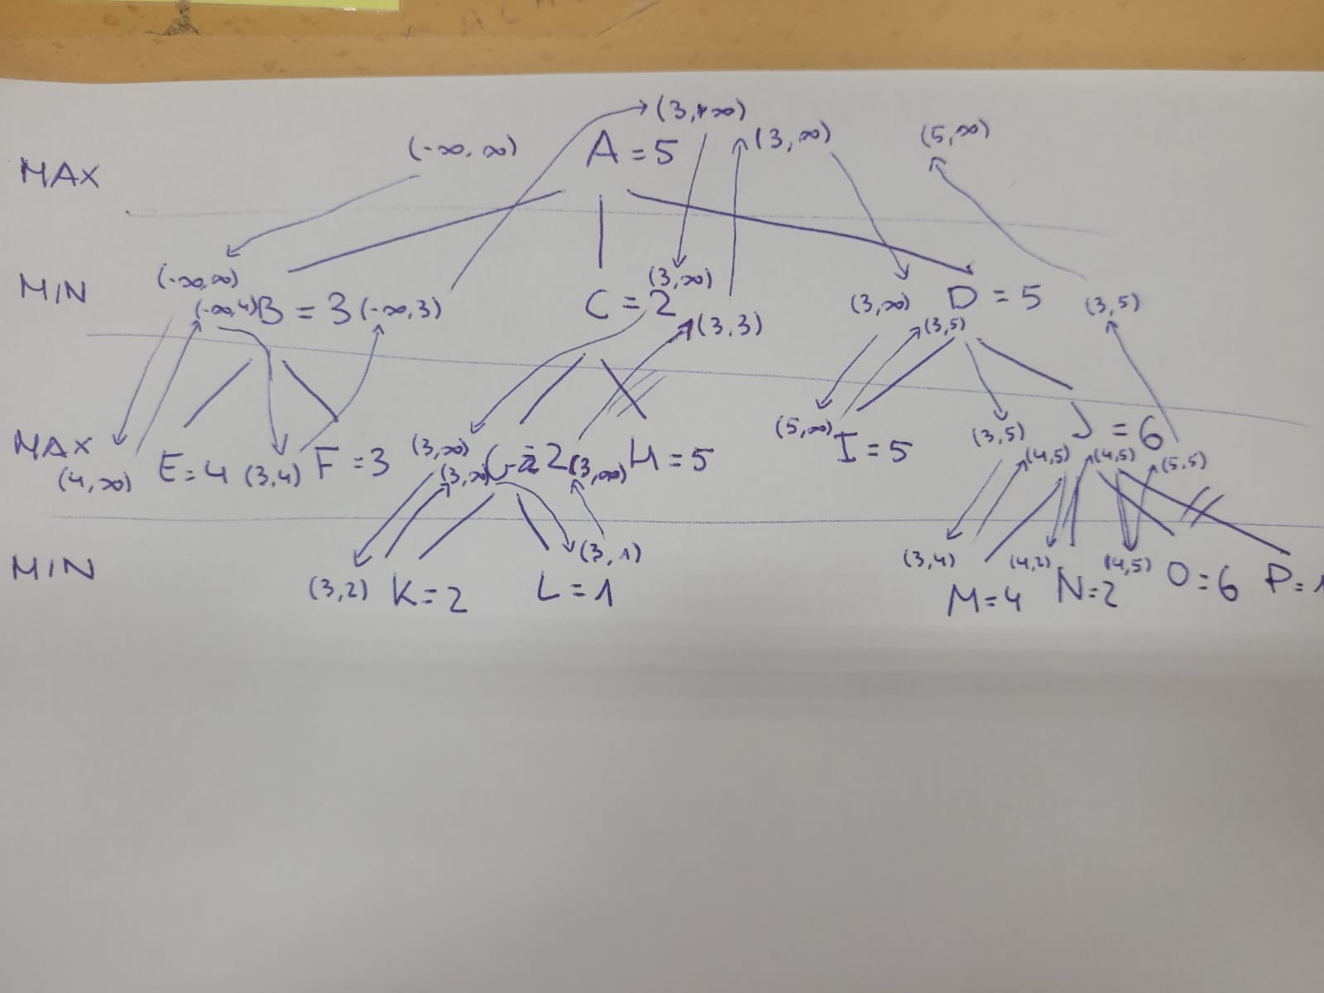

Slide 2
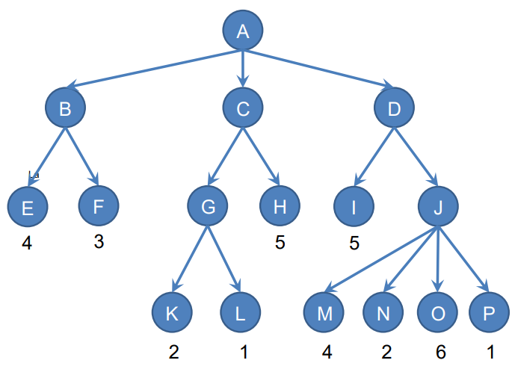
[1] (-∞, ∞)
[27] (5, ∞)
MAX
[7] (3, ∞)
[15] (3, ∞)
minimax= 5
[16] (3, ∞)
[18] (3, 5)
[2] (-∞, ∞)
[8] (3, ∞)
[26] (3, 5)
MIN
[4] (-∞, 4)
minimax= 3
[14] (3, 3)
minimax= 2
minimax= 5
[6] (-∞, 3)
[9] (3, ∞)
[5] (3, 4)
[11] (3, ∞)
[17] (5, ∞)
[3] (4, ∞)
[13] (3, ∞)
[19] (3, 5)
MAX
minimax= 6
[21] (4, 5)
[23] (4, 5)
minimax= 2
[25] (6, 5)
[10] (3, 2)
MIN
[12] (3, 1)
[20] (3, 4)
[22] (4, 2)
[24] (4, 6)

Slide 3
A minimax= 5
B minimax=3
C minimax=2
D minimax=5
E minimax=4
F minimax=3
G minimax=2
H minimax=5

